Slide 1
AI Pre-Hackathon
Enablement Session

Slide 2
AI Tasks
Use Vertex AI search to create a simple RAG application (on public Alphabet earnings documents)
Enable MaaS API, use MaaS in a Rag Pipeline
Agentspace: Search and act on your data
NotebookLM: chat with your sources, create mindmap, create FAQs, etc

Slide 3
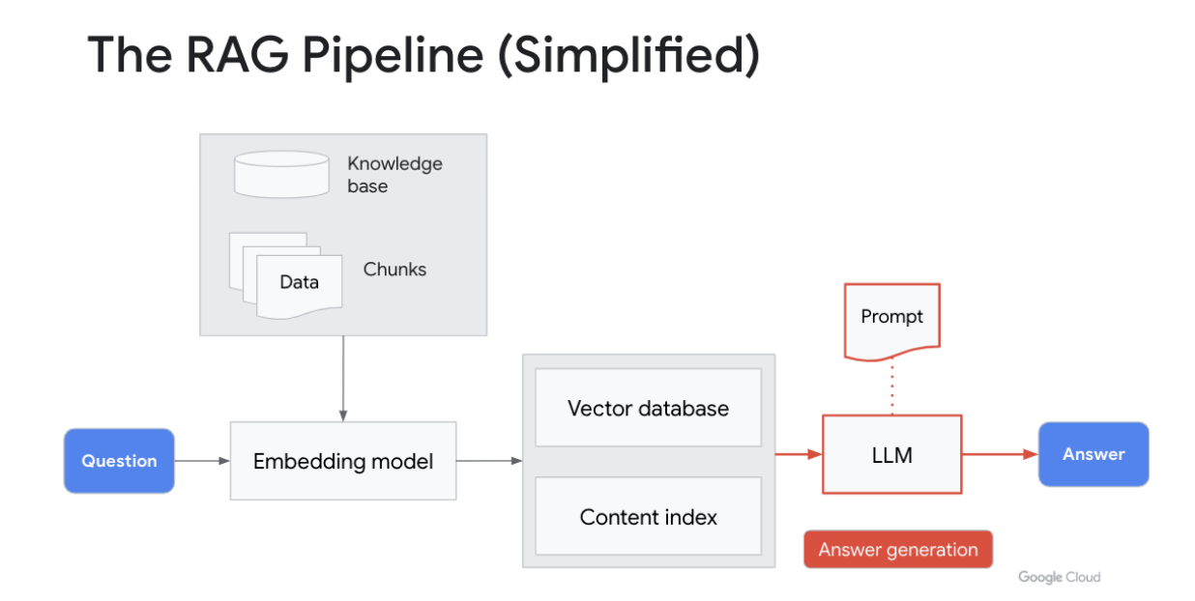
Enable MaaS API, use MaaS in a Ran Pipeline
Notes:
Lab link: https://explore.qwiklabs.com/focuses/7920?parent=catalog

Slide 4
Enable MaaS API, use MaaS in a Rag Pipeline
Step 1 - Open the notebook MaaS_Models_plus_VAIS.ipynb in Vertex AI Workbench. Vertex AI > Workbench > Open JupyterLab button.
The "Simple RAG App" section sets up a RAG pipeline on public Alphabet earnings documents. We leverage Vertex Search API, called Discovery Engine, for this section. Read more here.
These cells create a datastore, upload documents to the datastore, creates the search engine, and compiles the search helper function we will use later on in this lab.
Stop here: "Use Mistral Model as a Service (MaaS)" Section.
Step 2: Go to Model Garden and enable API for model you want to use. Vertex AI > Model Garden > Search for "Mistral Large" > Click Enable API
Once you have the API enabled run through the cells under "Use Mistral Model as a Service (MaaS)" Section.
Vertex Search allows you to get the extracted segments of your documents (read more here). You can then pass the extractive segments to your open source / partner model for the Answer Generation step.
Step 3: Run MaaS models across simple RAG app: "RAG (Vertex Search) + OSS/Partner MaaS model" section of the Jupyter Lab.In cell 111, pick the model of your choice or run across a list of models to see how the outputs vary based on the model we choose.

Slide 5
Agentspace
Create app
Create data store
Search
Tools/Actions
Agents

Slide 6
NotebookLM
Research assistant

